Slide 1



Rent N’ Glide
Electric scooter rental application
Project Group 22
Adithya Kupparavalli Madhusudana
Harikrishna Balamurali
Sai Siddaraju Poojitha

Slide 2
INTRODUCTION
The electric moped rental platform is designed to transform short-distance commuting in urban areas, providing an eco-friendly, cost-effective, and convenient mode of transportation.
Facilitates bike owners to list their bikes for rental and earn when their bike is idle.
Customers can provide a reason for rent with duration and rent the nearest bike.
The platform emphasizes community bonding by connecting owners and customers.
This project endeavours to transform short-distance travel by offering a user-friendly platform enabling convenient and affordable bike rentals in urban areas and also allows earning an extra income.

Slide 3
Problem Statement
Time-consuming public transport facilities
Expensive bike rental platforms
Tedious supply chain maintenance of rental bikes offered in existing rental platforms
Electric bike owners with their unutilized vehicles
No facility for renting personal vehicles to the public
Lacks community connections

Slide 4

OBJECTIVES
Develop an intuitive website/app interface allowing owners to easily list their bikes for rent, in a similar fashion customers to easily locate and rent bikes.
Establish a system to monitor bike availability in specific locations
Implement a feedback and rating system enabling customers to share experiences

Slide 5

SCOPE
Creating a bike rental service to make city commutes easier
The platform is created not only for people who need a bike now and then. It's also for people who own bikes but want to share them
Getting bike owners involved, we're creating a community where everyone can help each other travel easily
The Project would primarily focus on complete travel solution from renting bikes for a short time to letting people share their own bikes
The Project could help making connections easy to find bikes or find someone to rent their bike

Slide 6
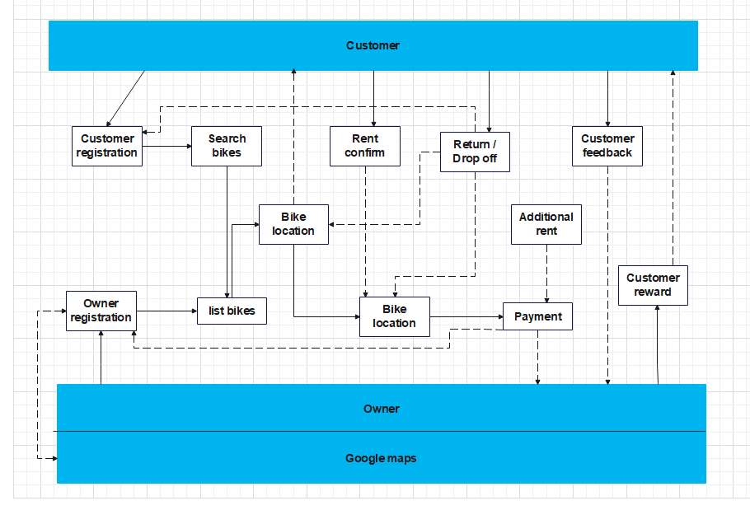
Business Product Model Notation (BPMN)

Slide 7
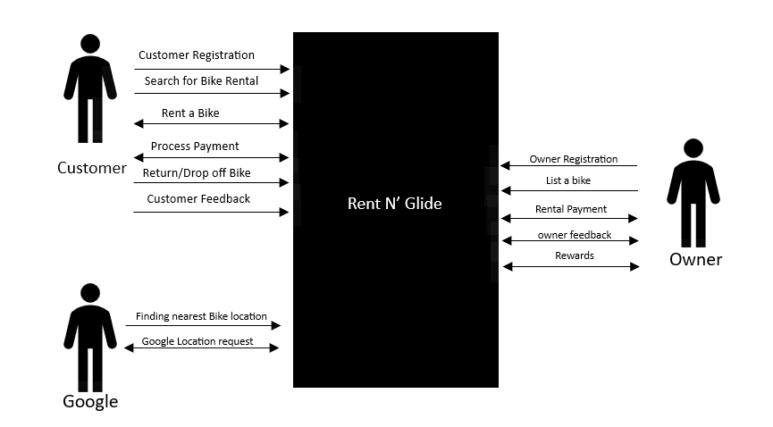
CONTEXT DIAGRAM

Slide 8
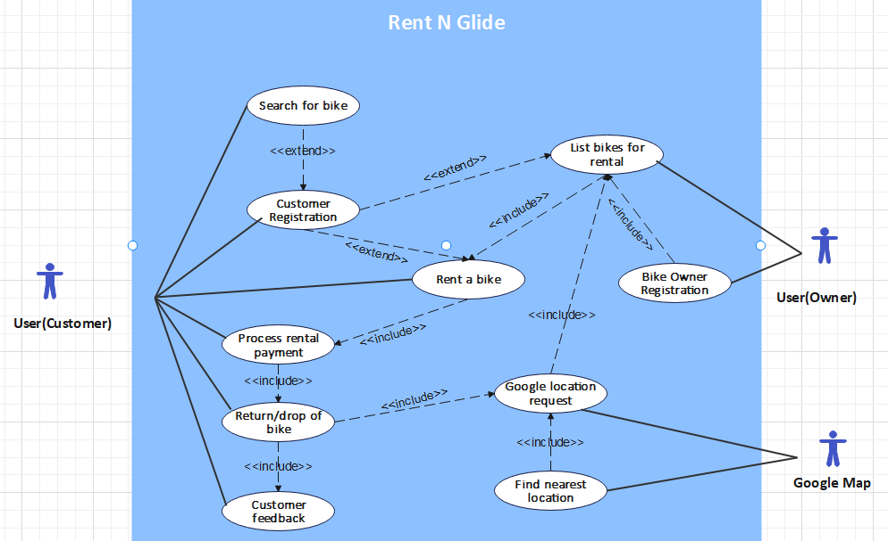
USE-CASE DIAGRAM

Slide 9
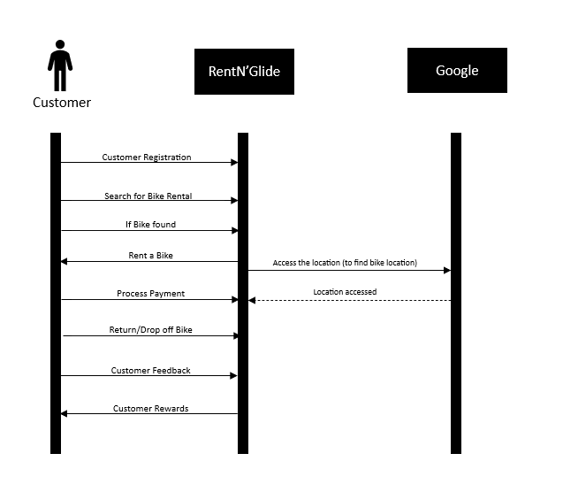
SEQUENCE DIAGRAM

Slide 10
CLASS DIAGRAM

Slide 11
App Opening Page
Get Started as Owner
Get Started as Customer

Slide 12
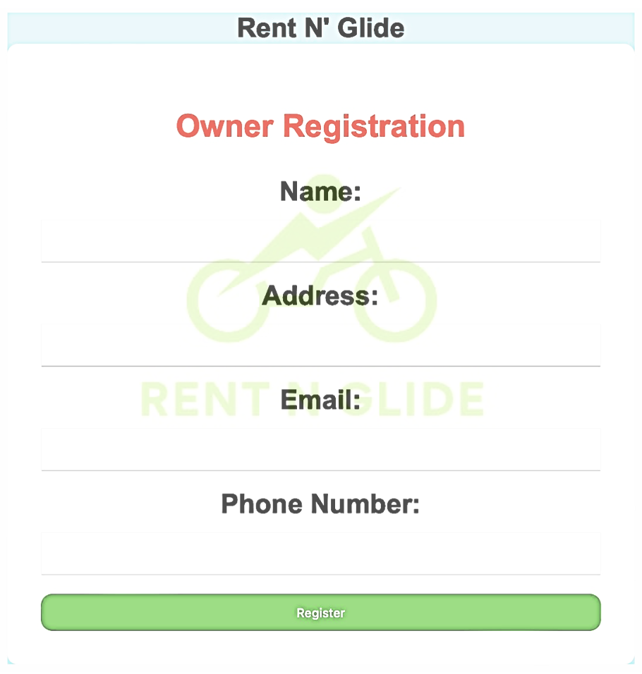
Owner Registration Page

Slide 13
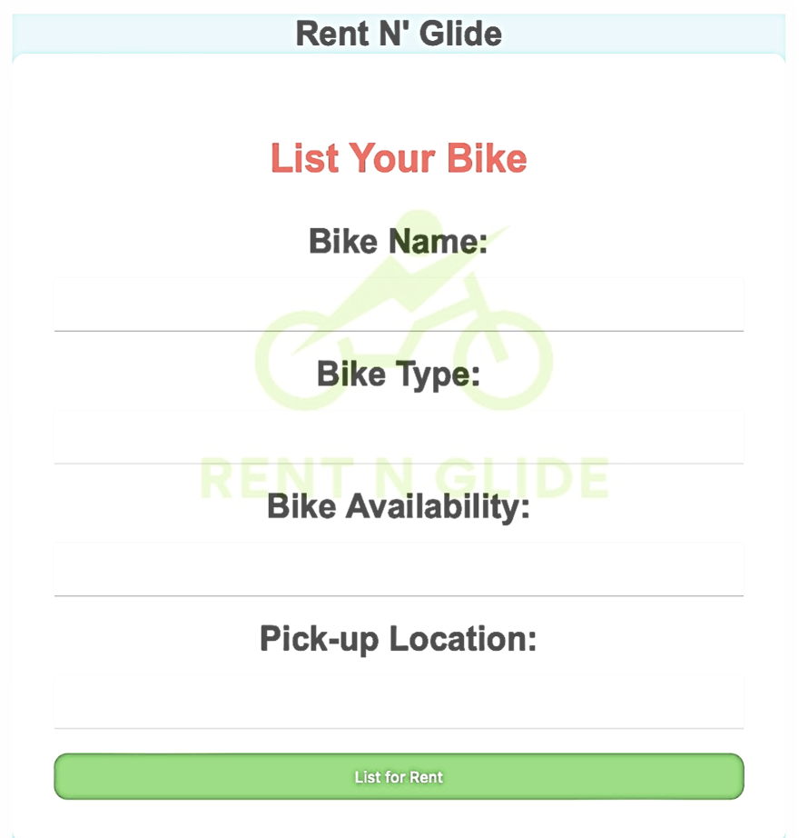
List your Bike Page

Slide 14
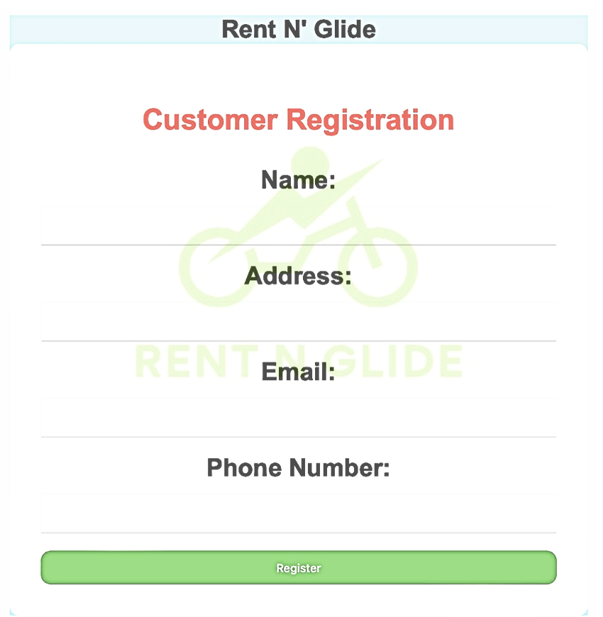
Customer Registration Page
Notes:
The second page gives a selection of the 3 choices, employee, Human resource employee and project manager. Each of these will have a different user interface which will collect information as needed.

Slide 15
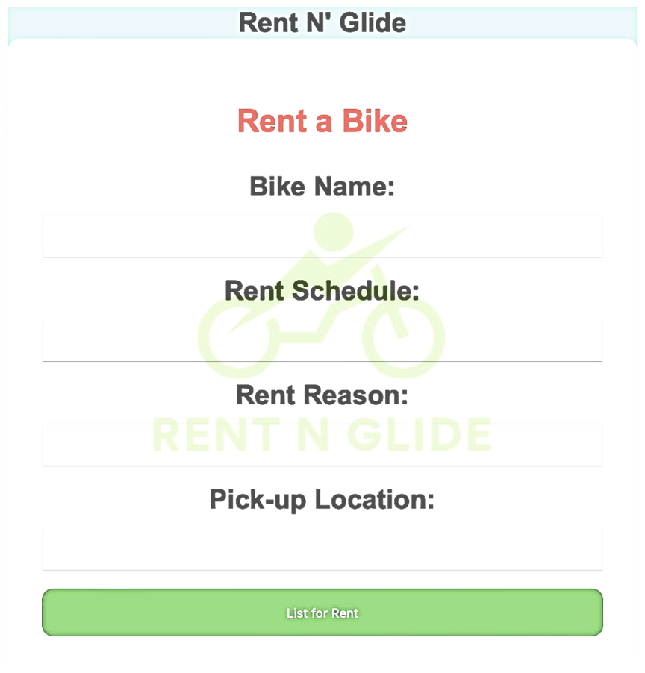
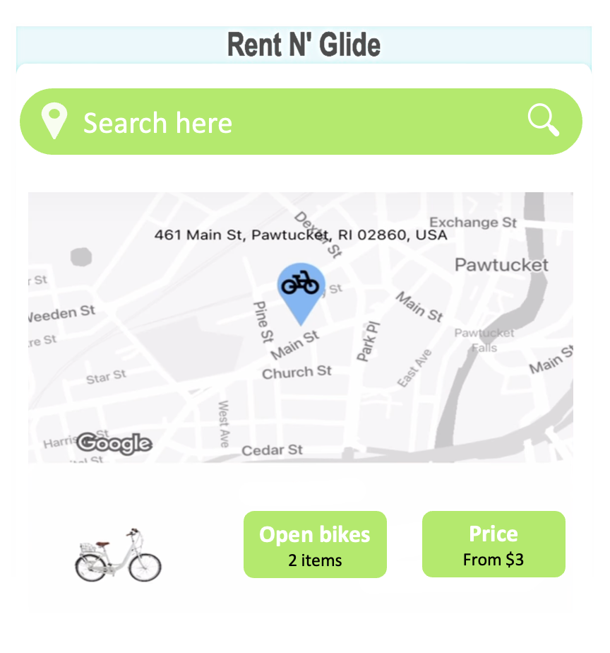
Rent a Bike Page
Search for Bike:
Confirm Bike
Notes:
This page will pop up when the user selects the employee option from the previous menu

Slide 16
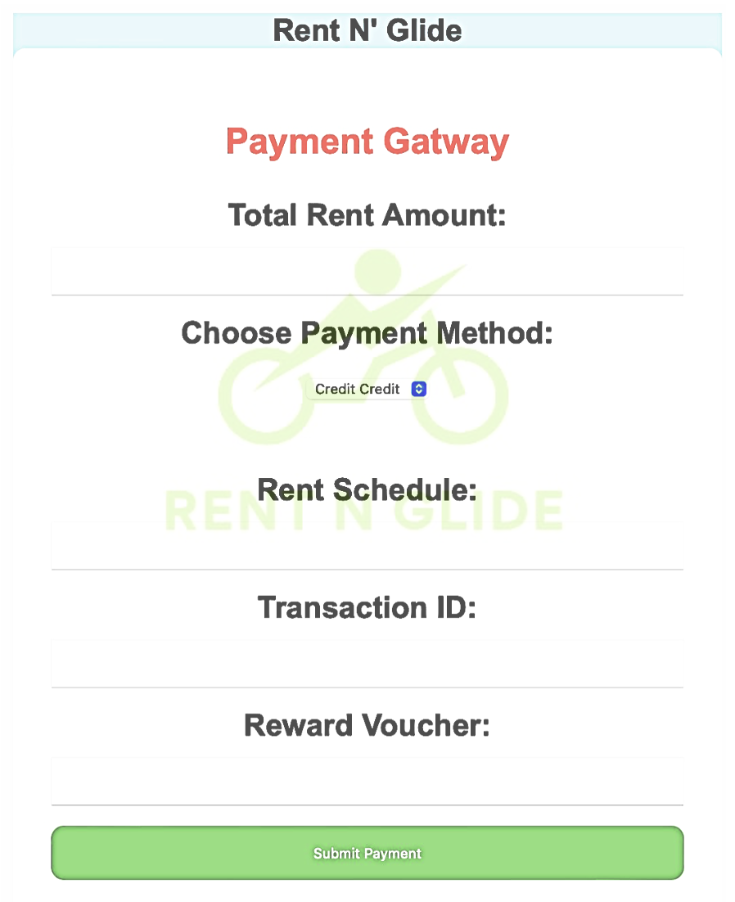
Payment Gateway Page
Notes:
This page indicates that the employee is done with their task and can now exit the application.

Slide 17
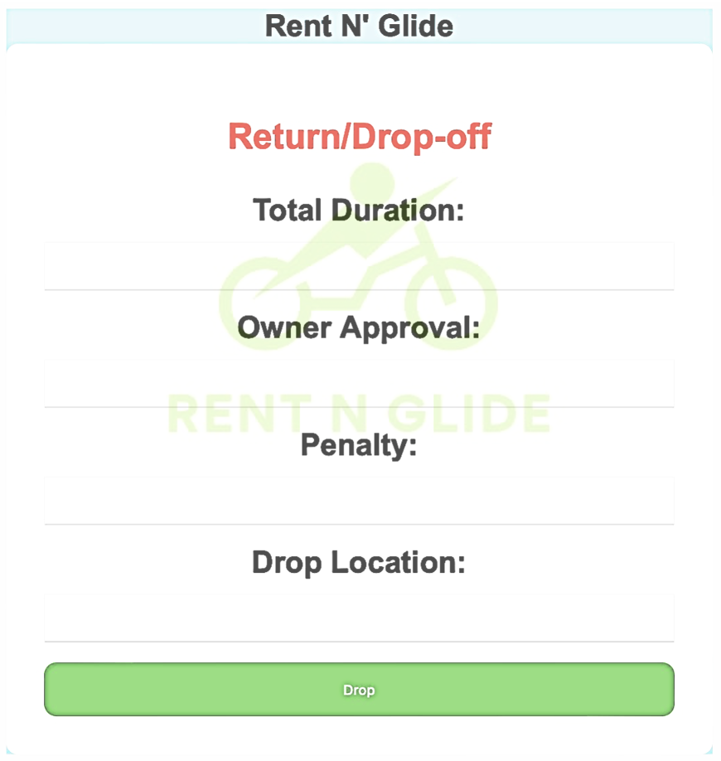
Return/Drop-off Page
Notes:
This page collects information from the employee and stores it in the database. The algorithm runs based on the information collected in this page. The resume box provides a link for the employee to upload their resume and later the system will parse it.

Slide 18
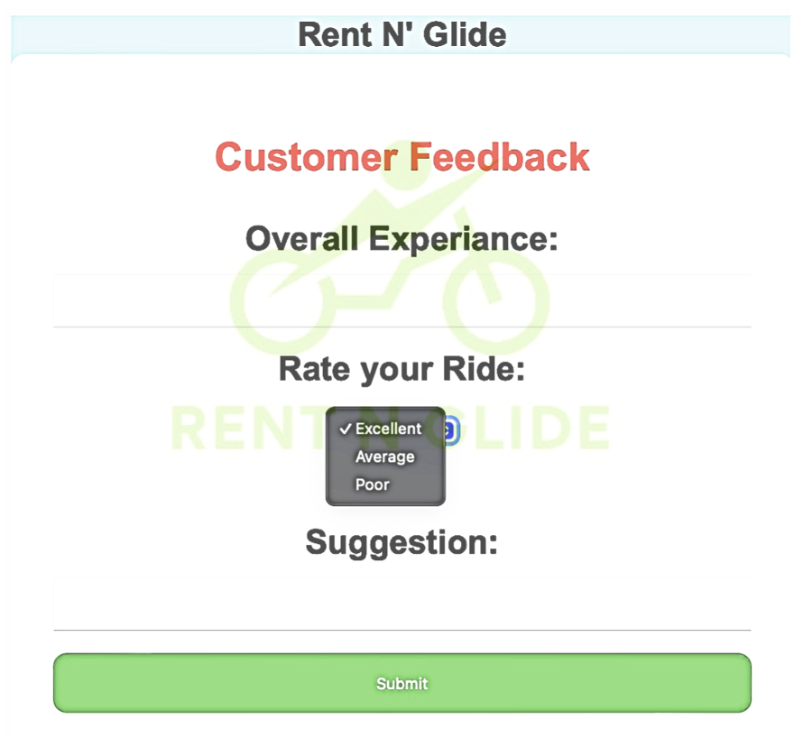
Customer Feedback Page
Notes:
This page is displayed when the project manager option is selected.

Slide 19
THANK YOU

